Slide 1
Social Content Sharing Platform
Week 2 Submission
Batch: B02
Aasif Khan ⋅ 20CS1A3121
Sayan Ghosh ⋅ 20CS1A3131

Slide 2
The problem
Company
Context
Problem statement
Current Social Media Platforms are company / advertiser centric.
The content ranking algorithm used by them is proprietary and advertiser-centric and does not benefit the user.
Users want to be in control of the posts they see.
Users want posts to be ranked according to their merit and age.
Users want to be able to follow other users.
Create a diverse and equal platform for all users where content is sorted algorithmically using their merit, decided by the community.
Users get to choose who they follow.

Slide 3
Challenges deep-dive
Challenge 1
Challenge 2
Challenge 3
Audience-centric algorithm
Device a fair algorithm that is based on community taste of a post.
New posts should outrank old ones
To avoid oversaturation, newer posts should be given higher priority over old posts.
User should be able to express opinion
Let user not only express liking, but also express their disliking of a post or comment, for better ranking.

Slide 4
Solution
SCSP devices a mix of social platforms, using all the benefits and discarding all disadvantages
SCSP

Slide 5
Modules

Slide 6
View and open notifications received by a user pertaining to his account and posts. Get notified about peers commenting on your posts.
View content shared by peers whom you follow. Content is sorted so that newer and better content is shown first.
User Account - View / Change account details like name, bio, dp. Users can only change their own details post authentication.
Discover
Messaging
User Account
Content Upload and Post
Notification Centre
Chat with your peers or anyone else in the world. Chats are asynchronous and stored on a centralised server.
Let users upload and share content. Store the content in the database and let it be accessible to all other users who follow him.

Slide 7
Change site settings on a per-user basis. Toggle between light and dark mode. Clear cache and stored cookies.
Show statistics and data about users, registrations, posts, comments, and other similar insights about the platform.
Settings
Donate
Admin Dashboard
Support the application with donation. Donations are optional and do not affect any functionality of the application.

Slide 8
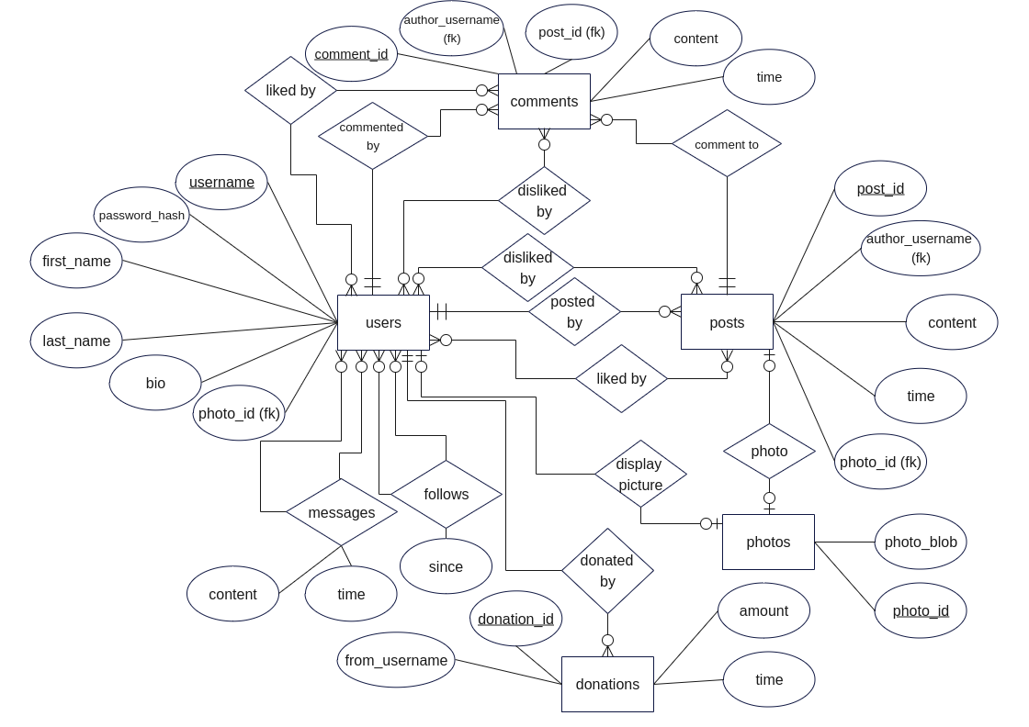
Entity Relation Diagram

Slide 9
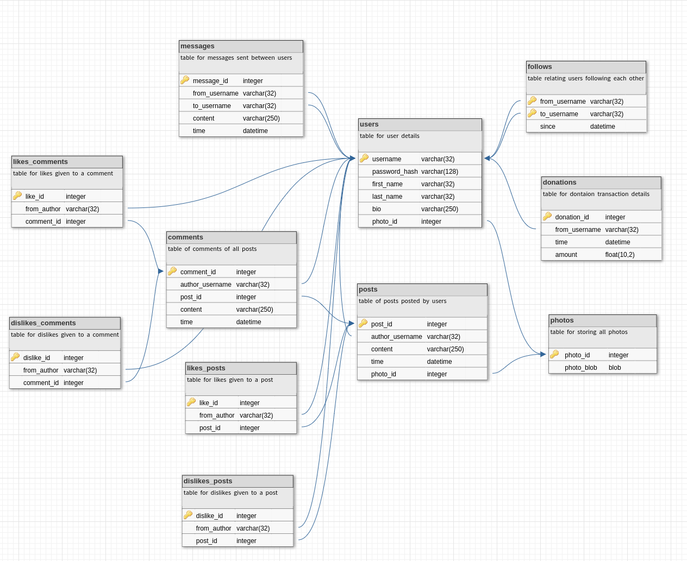
Table Schema

Slide 10
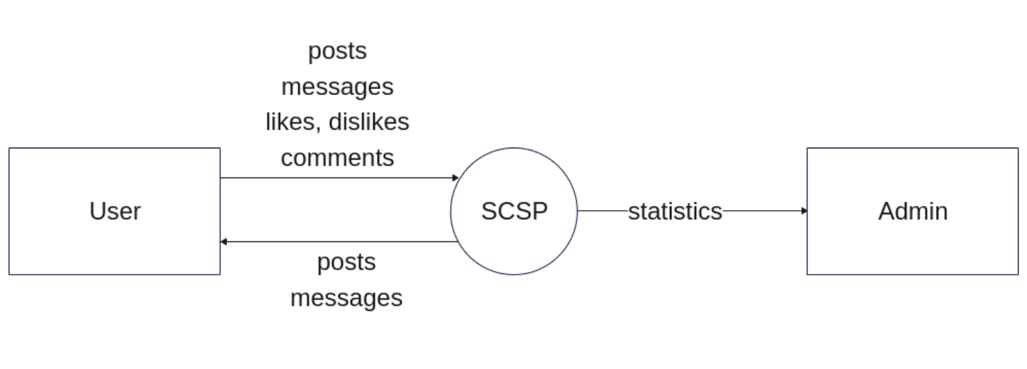
Data Flow Diagram (level 0)

Slide 11
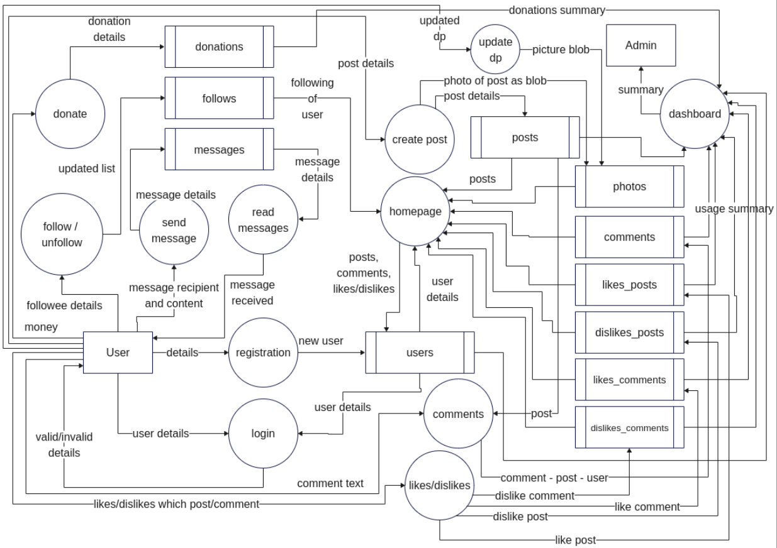
Data Flow Diagram (level 1)

Slide 12
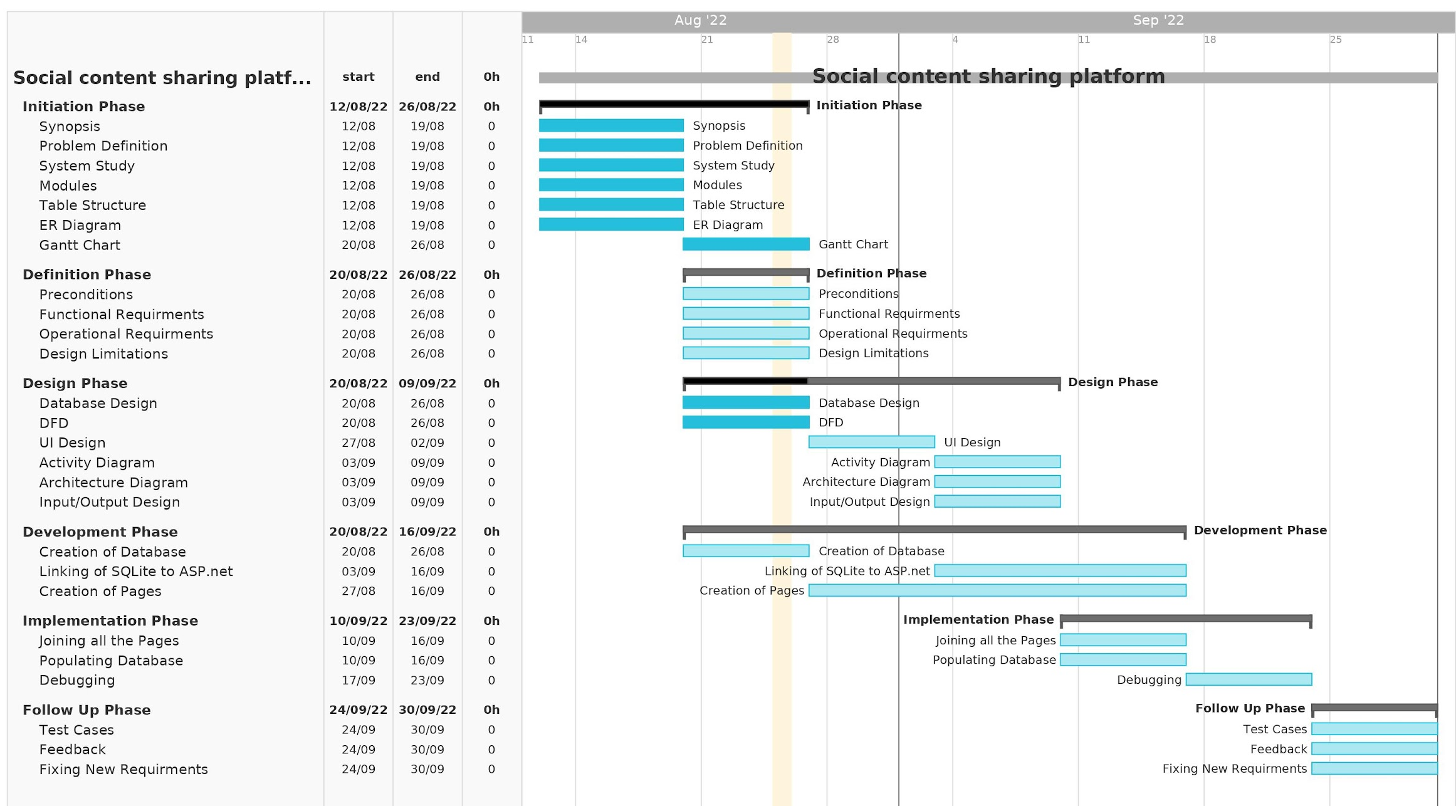
Timeline
Gantt Chart

Slide 13
Thank You
Batch: B02
Aasif Khan - 20CS1A3121
Sayan Ghosh - 20CS1A3141

